Slide 1
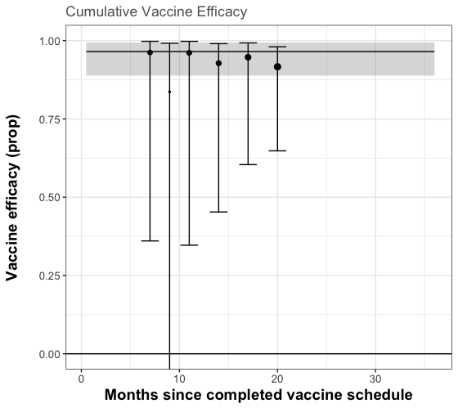
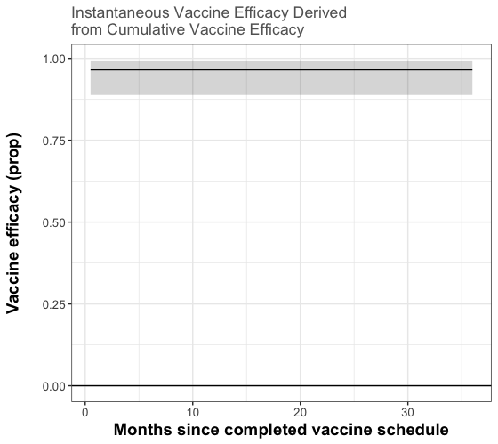
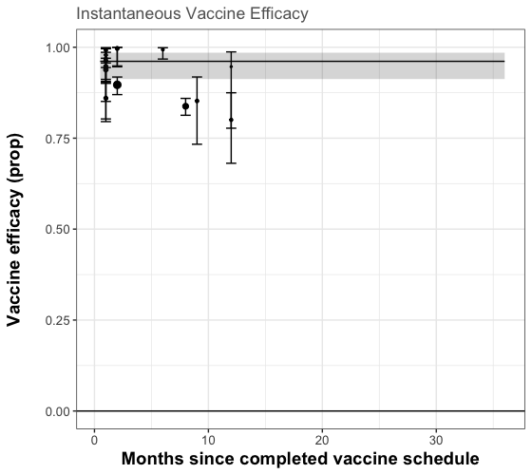
No waning
DIC: 51.34
DIC: 213.9
Time point | P value | 95% Credible Intervals
All | 0.437 | 0.061[-0.072-0.005]

Slide 2
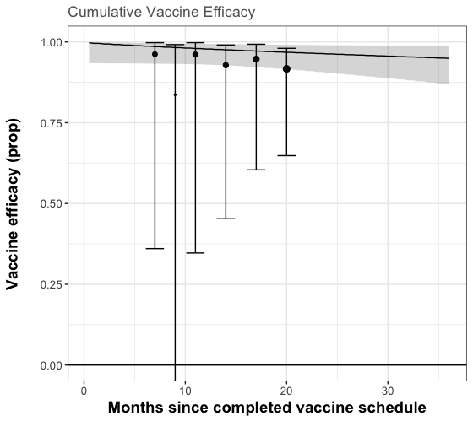
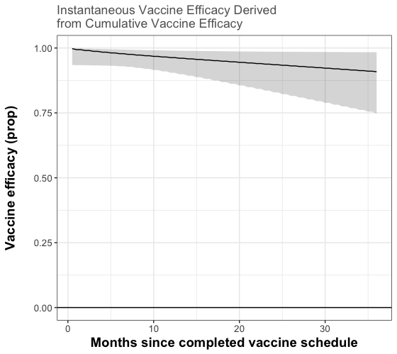
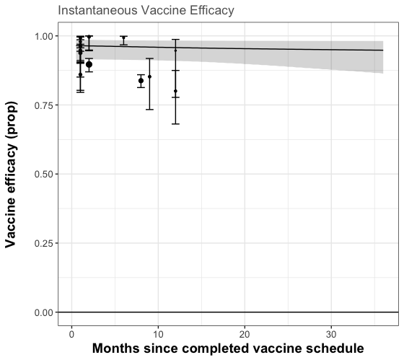
Waning: Linear
DIC: 49.28
DIC: 214.1
Time point | P value | 95% Credible Intervals
2 weeks | 0.115 | 0.028 [-0.039 - 0.078]
12 months | 0.526 | -0.003 [-0.112 - 0.114]
30 months | 0.658 | -0.047 [-0.329 - 0.250]

Slide 3

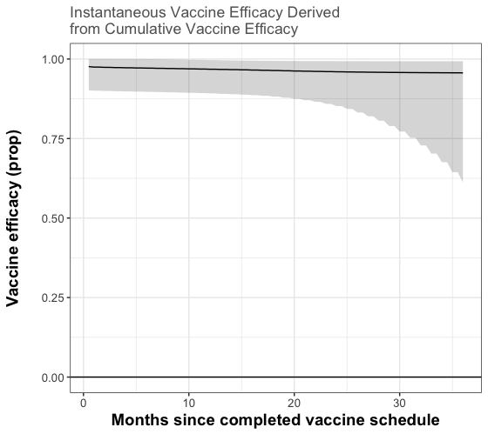
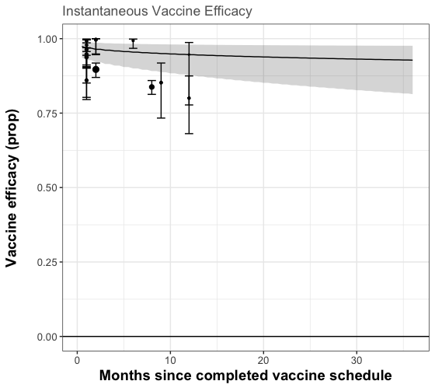
Waning: Power
DIC: 51.07
DIC: 208.0
Time point | P value | 95% Credible Intervals
2 weeks | 0.407 | 0.007 [-0.065 - 0.052]
12 months | 0.207 | 0.039 [-0.074 - 0.177]
30 months | 0.303 | 0.042 [-15.625 - 0.266]

Slide 4

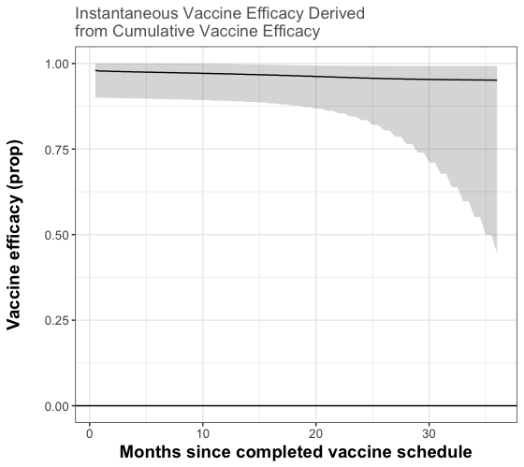

Waning: Power_01
DIC: 51.18
DIC: 207.6
Time point | P value | 95% Credible Intervals
2 weeks | 0.374 | 0.010 [-0.073 - 0.053]
12 months | 0.202 | 0.044 [-0.082 - 0.182]
30 months | 0.388 | 0.034 [-1.842 - 0.255]

Slide 5
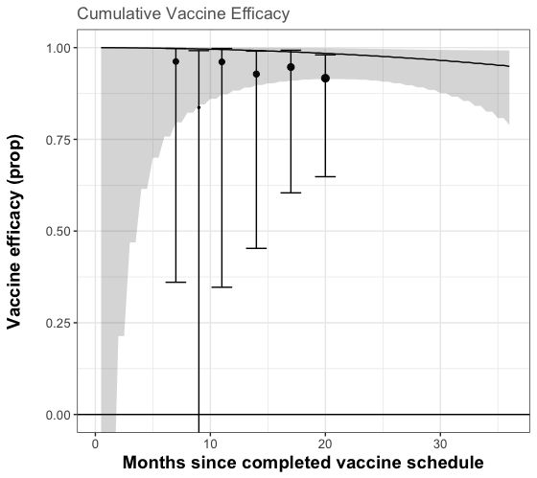
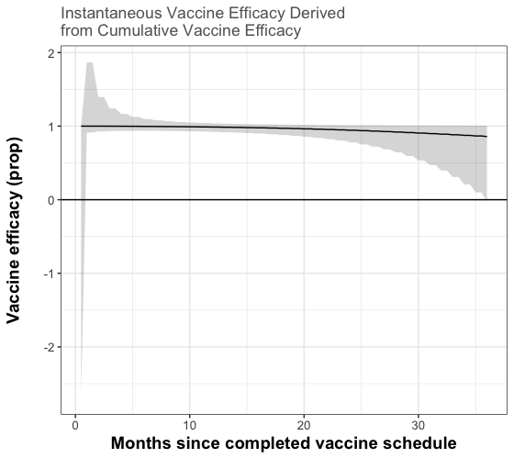
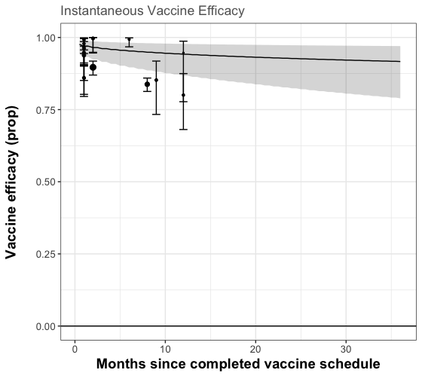
Waning: Power_2
DIC: 50.54
DIC: 206.9
Time point | P value | 95% Credible Intervals
2 weeks | 0.141 | 0.020 [-0.408 - 0.053]
12 months | 0.237 | 0.043 [-0.116 - 0.207]
30 months | 0.702 | -0.361 [-13.176 - 0.253]

Slide 6
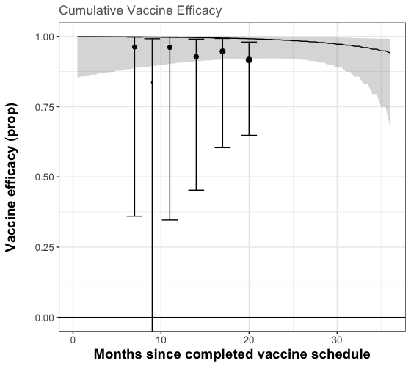
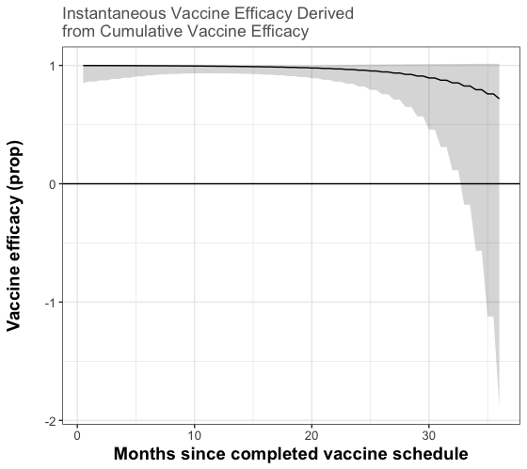
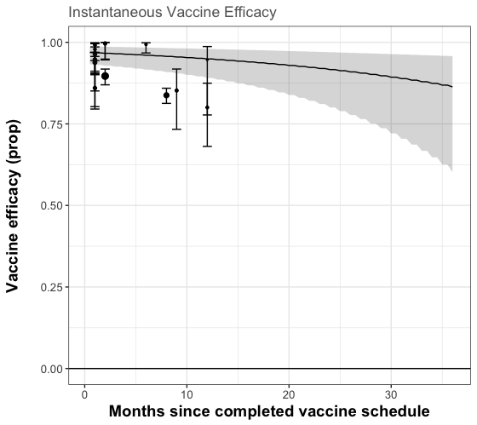
Waning: Power_3
DIC: 50.73
DIC: 206.9
Time point | P value | 95% Credible Intervals
2 weeks | 0.094 | 0.027 [-0.068 -0.064]
12 months | 0.058 | 0.118 [-0.034 -0.406]
30 months | 0.711 | -8.049 [-16677.37 - 4.977]

Slide 7
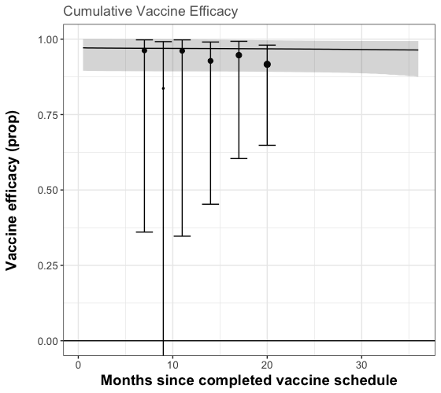
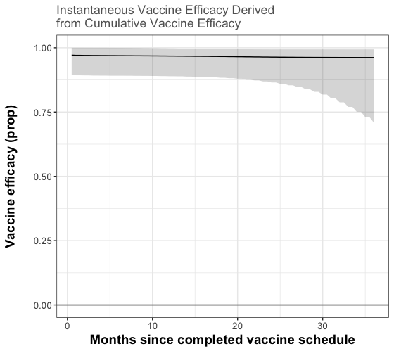
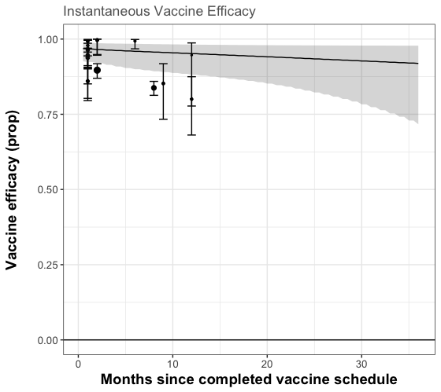
Waning: Power_sigmoid
DIC: 51.35
DIC: 208.6
Time point | P value | 95% Credible Intervals
2 weeks | 0.463 | 0.003 [-0.073 - 0.054]
12 months | 0.191 | 0.040 [-0.062 - 0.238]
30 months | 0.189 | 0.048 [-0.093 - 1.348]

Slide 8

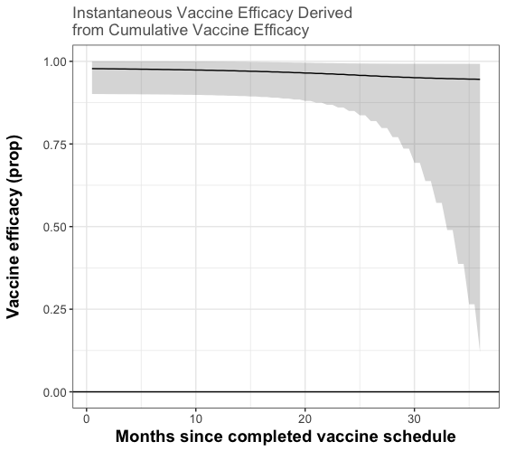
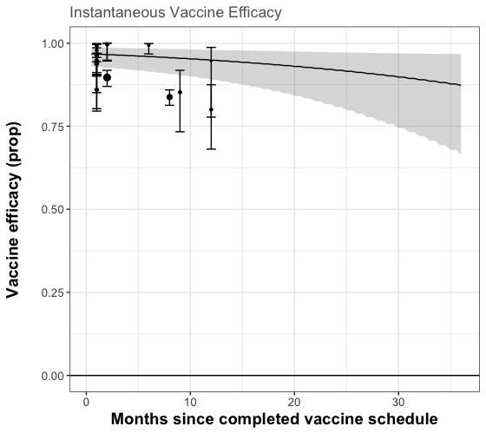
Waning: Power_sigmoid_01
DIC: 51.29
DIC: 207.8
Time point | P value | 95% Credible Intervals
2 weeks | 0.336 | 0.013 [-0.065 - 0.059]
12 months | 0.081 | 0.100 [-0.039 - 0.347]
30 months | 0.268 | 0.439 [-2.135 - 1.494]

Slide 9
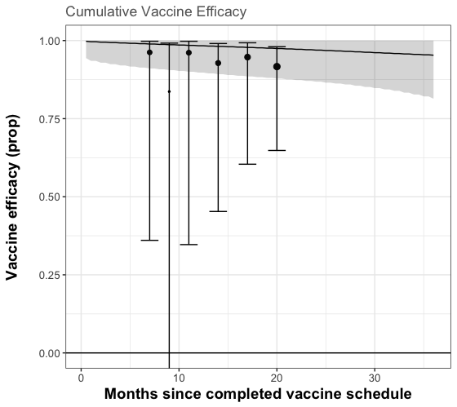
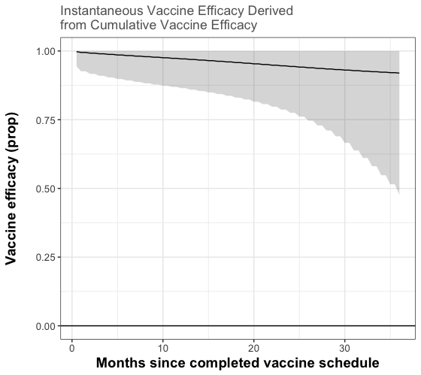
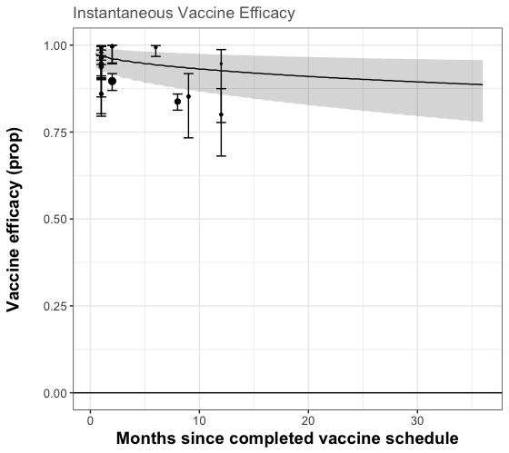
Waning: Power_gamma_01
DIC: 206.0
Time point | P value | 95% Credible Intervals
2 weeks | 0.134 | 0.020 [-0.038 - 0.061]
12 months | 0.147 | 0.073 [-0.096 - 0.223]
30 months | 0.303 | 0.073 [-0.838 - 0.350]

